Slide 1
Welcome to 10P1 with Mrs Bevin in A11 krystal.bevin@det.nsw.edu.au

Slide 2
Things to chat about
Discussion of course –
Course structure – asst schedule/scope
Film Note – return permission slip
signature when received all docs
Equipment/workbooks/devices
Using email – krystal.bevin@det.nsw.edu.au
Websites - ccwcenglish.weebly.com and bevspace.weebly.com
A-stream expectations –
Due dates + homework
Diary/calendar use
Quality workbook organisation
Wide reading
Competitions
Step Up program

Slide 3
What else?
Focus on vocabulary development
Ask questions and seek feedback – most importantly, be prepared to apply the feedback – this may involve multiple drafts…
Read, write, blog and watch films for fun
Be prepared to work individually and in groups (that you may not choose)
Be ready to share and to give constructive, considered and kind critique (and to receive it gracefully)

Slide 4
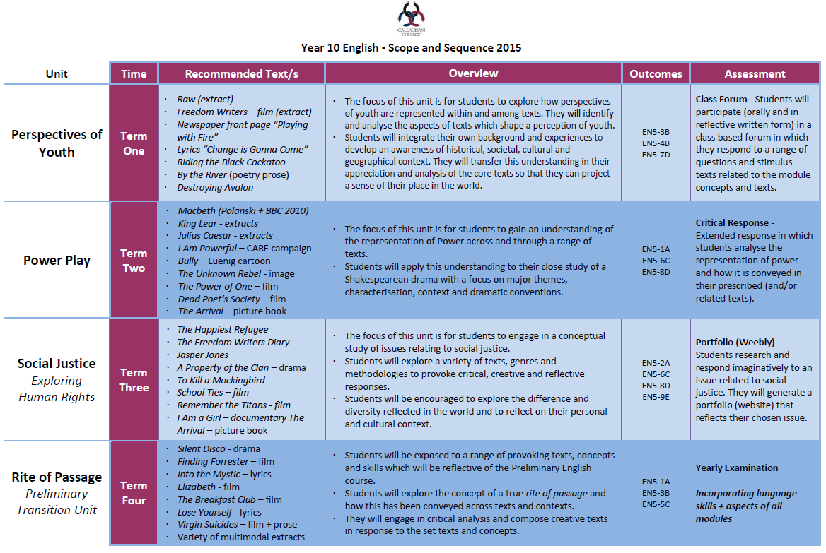

Slide 5
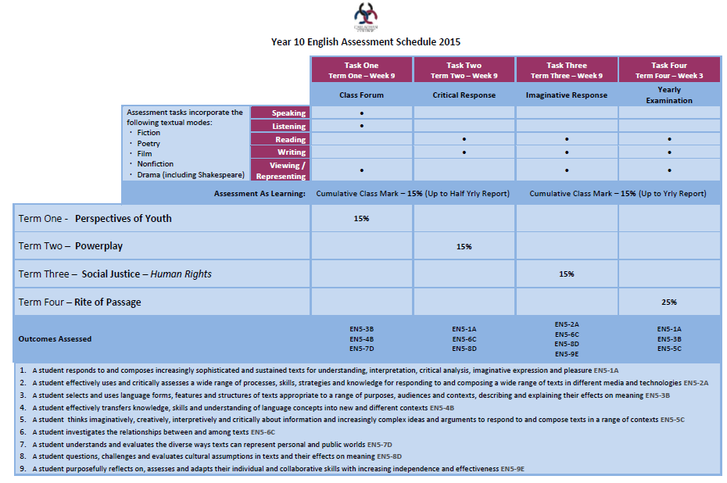

Slide 6
BEVSPACE.WEEBLY.COM

Slide 7
Any questions so far?

Slide 8
Connection with English Task
As an A-stream student, you should endeavour to foster and develop a genuine connection to this subject.
So, what is your connection to English?
Do you have a favourite book, film or blog? Do you have a passion for writing poetry, debating or critical thinking? What is it that will help you to connect to English and succeed in this subject?

Slide 9
First writing task…
Introduce yourself and respond to the question in any form you like. You may interpret the question creatively. The length is up to you…
But remember, first impressions are everything.
Email or submit your response to Mrs Bevin
by 9am tomorrow.
krystal.bevin@det.nsw.edu.au

