Slide 1
Perspectives of Youth
Introductory Activity – Humans of New York

Slide 2
Thinking About the Concept
What does the word “perspective” mean?
How would you define the term “youth”?
With that in mind, what do you predict we will be studying this term in our module “Perspectives of Youth”?

Slide 3
Food for Thought
Can one person’s perspective, their point of view, be powerful enough to change the world?

Slide 4
Humans of New York.com Perspectives from Everyday People
What is HONY?

Slide 5
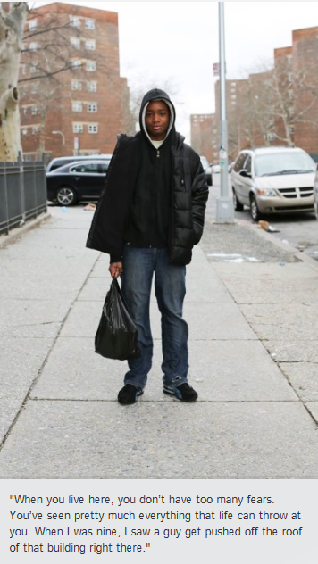
Let’s take a look at a recent photo blog on HONY…

Slide 6
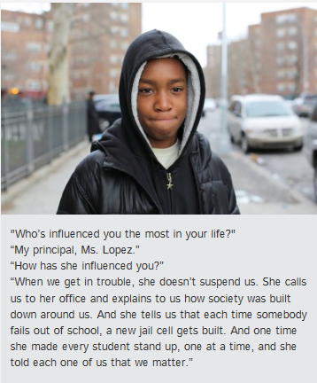
How does this one random encounter develop?

Slide 7
What happens next is pretty cool... It is an example of how one person (and their perspective or view on the world) can affect real and meaningful change.

Slide 8
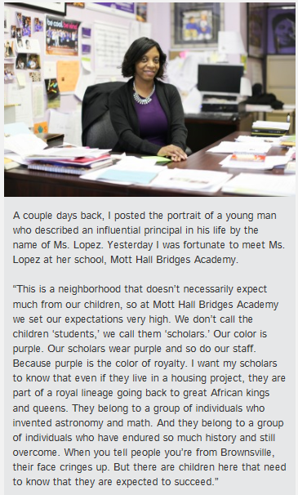

Slide 9
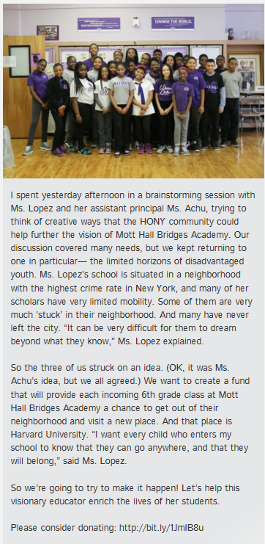

Slide 10
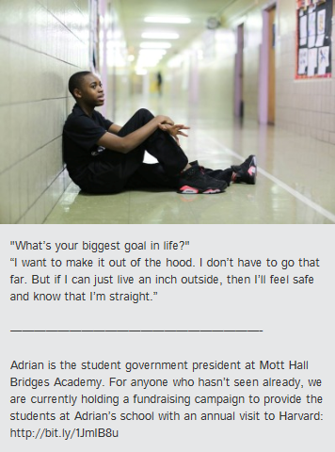
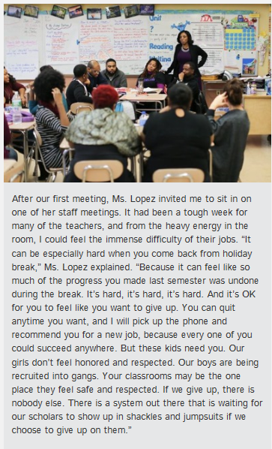

Slide 12
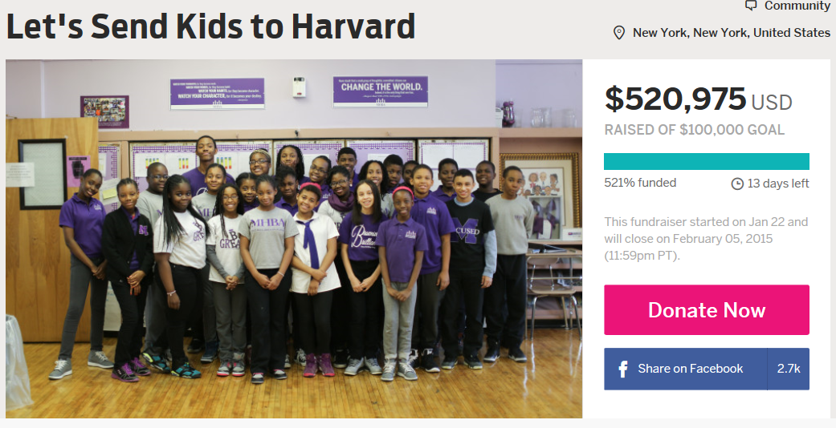
All this… in just one day.

Slide 13
HONY ACTIVITY
1. On your own device or using one of the PCs go to the HONY website:
www.humansofnewyork.com
2. Spend some time reading through the photo blogs. You can discuss them with a friend if you like.
3. Individually, choose THREE of the photo blogs that you find the most interesting or engaging.
4. Use a snipping or screenshot style tool to copy these photos into a document titled – Perspectives of HONY. Be sure to include your name.
5. For each of the three photos write a paragraph explaining why you think it is interesting or important or emotional or shares a unique perspective. Consider why you think the blogger published the photo in the first place.
6. Email your document to krystal.bevin@det.nsw.edu.au for marking.

Slide 14
EXTENSION ACTIVITY
Social fundraising sites such as INDIEGOGO are becoming more and more popular. They allow individuals to share their voice and rally support.
In a small group, brainstorm an idea worthy of online community donations and create your pitch following the INDIEGOGO guidelines.
The class will then vote for the most worthy and convincing pitch!

