Slide 1
How to improve your essay writing
Responding to the type of feedback you may have had… or may get…
What is your teacher talking about?

Slide 2
The comments
Grammar needs improvement
Does not have a thesis
Lacks essay structure
Too much recount
Thesis is not sustained
Does not engage the question

Slide 3
Grammar needs improvement
This problem is easily fixed for most of you. You just need to remember the ‘rules’ that you learned in primary school.
All Proper nouns (names of people, places or texts) NEED a capital letter
New idea = new paragraph
Keep your essay in the same tense (past, present, future). In essays you write in the present tense, i.e. “The author shows...”
DO NOT use contractions in formal writing – don’t, shouldn’t, can’t, won’t
Now go through your essay and fix any
grammatical errors that you can find

Slide 4
Does not have a thesis
This is very, very, very important because
Without a thesis we have no idea what you are arguing : (
YOU NEED A THESIS!!!!

Slide 5
Your thesis is your opinion
It is easier to stick with the group than stand alone and fight for true justice.
How have the characters in the text you have studied challenges the group’s perception of justice?
This is the part of the question that you are either agreeing with OR disagreeing with
So do you agree or disagree?
This is how you are going to prove that your argument is the correct one

Slide 6
Agree or disagree?
It is easier to stick with the group than stand alone and fight for true justice.
Look at your essay and if you do not have a thesis statement then add a sentence that tells me whether you agree or disagree with this statement.
If you have one please put your hand up
because I would love to read it!

Slide 7
A good example from one of you!
By joining and melding with a group that shares similar views and characteristics, you are sheltered from the indirect vagueness of an outside attacker.
I think the word ‘danger’ would work!
If this is your work then I would probably change this phrase to improve my thesis

Slide 8
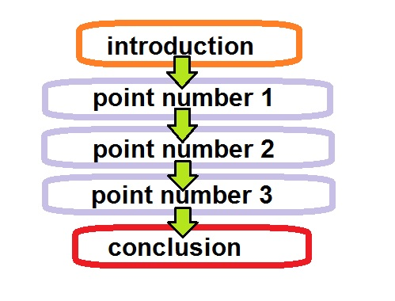
Lacks essay structure
To get out of the D range ALL elements of the essay must be present!!
The essay should also ‘flow’. If it doesn’t then your feedback probably says ‘lacks cohesion’
To begin
And
Also
As well as
In sum-mary
Connective words and phrases
help with flow
Now check if you have all of the elements!!

Slide 9
Too much recount
This is a doozey!!!
So many of you retold the story of The Lord of the Flies and did not discuss ANY techniques.
BTW: What do you think those capital letters symbolise?
WHY THE HECK DO YOU THINK WE CREATE ALL OF THOSE T.E.E. TABLES?

Slide 10
Turning a recount into an essay
At first there was only one tribe and the leader or the chief was Ralph. Ralph was a good chief he made the conch rule and some other rules as well. Everyone respected him, trusted him, admired him. They even said that he was a good chief.
Symbolism
Characterisation
dialogue
Can you pick out THREE techniques that this student could have included to make this an analytical paragraph and not a recount?

Slide 11
The new and improved paragraph
At first there was only one tribe and the leader, or the chief, was Ralph. Golding characterises Ralph was as a good chief who builds shelters for the tribe and who he made the conch rule and some other rules as well. The conch is a symbol of authority on the island, that is used to call the boys to the assembly. Everyone respected him, trusted him, admired him. They even said that he was a good chief. Ralph’s dialogue shows the audience why they might have thought this: "This is our island. It’s a good island. Until the grown-ups come to fetch us we’ll have fun."
Now find a paragraph of recount from your essay
and turn it into a good analytical one!

Slide 12
Thesis is not sustained
It’s one thing to come up with a good thesis, its a whole other thing to make sure you sustain that thesis through your essay.
SUSTAIN: cause to continue or be prolonged for an extended period or without interruption.
"he cannot sustain a normal conversation"

Slide 13
Sustaining the thesis
At first there was only one tribe and the leader, or the chief, was Ralph. Golding characterises Ralph as a good chief who builds shelters for the tribe and who made the conch rule and some other rules as well. The conch is a symbol of authority on the island, that is used to call the boys to the assembly. Everyone respected him, trusted him, admired him. They even said that he was a good chief. Ralph’s dialogue shows why they might have thought this: "This is our island. It’s a good island. Until the grown-ups come to fetch us we’ll have fun."
Remember the thesis from earlier?
By joining and melding with a group that shares similar views and characteristics, you are sheltered from the danger of an outside attacker.
Well we need to link this paragraph to this idea

Slide 14
Something like this
At first there was only one tribe and the leader, or the chief, was Ralph. Golding characterises Ralph as a good chief who builds shelters for the tribe and who made the conch rule and some other rules as well. The conch is a symbol of authority on the island, that is used to call the boys to the assembly. Everyone respected him, trusted him, admired him. They even said that he was a good chief. Ralph’s dialogue shows why they might have thought this: "This is our island. It’s a good island. Until the grown-ups come to fetch us we’ll have fun." Earlier in the novel all of the boys shared the same ideas about justice and order, however by the end of the story justice was gone and Ralph was alone and in danger.
Now reword the thesis that you wrote down earlier and add it to your own new and improved
analytical paragraph!!

Slide 15
Does not engage question
This comment means that even
though you may have written a
whole lot of good ‘stuff’, you have
not said anything about ‘justice’, or ‘fairness’, or ‘being safer in a group’ or ‘doing what is right’.
This is what you are supposed to be arguing about so you have to talk about it!
Please go through your essay and highlight any of the words or phrases that talk about justice
Re-write two of these examples in a way that refers to the idea of ‘standing alone’ or ‘being in a group’

Slide 16
Now the fun part!!!
To practice you are going to improve your essay by...
Re-writing it!!!
OH, YES YOU ARE ☺

